Slide 1
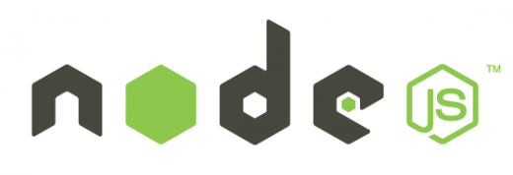
Node.js
Module 7 – Working With Data

Slide 2
Agenda
MongoDB
Mongoose ODM
Mongoose Schema
Mongoose Model
Querying with Mongoose

Slide 3
Data Access
Node.js excels in IO bound operations, this fact makes Node.js extremely attractive for data-centric, distributed systems.
You can find a modules for almost any database on NPM today

Slide 4

MongoDB
MongoDB is a document database
Stores BSON (Binary JSON) documents
Can search based on data stored in the BSON document
Easily return results in JSON
MongoDB is one of the Most popular databases in the Node.js eco-system

Slide 5
Node.js and MongoDB
MongoDB has an official driver for Node.js
http://mongodb.github.io/node-mongodb-native/
const MongoClient = require('mongodb').MongoClient;
// Connection URL
const url = 'mongodb://localhost:27017’;
// Database Name
const dbName = 'myproject’;
// Use connect method to connect to the server
MongoClient.connect(url, function(err, client){
console.log("Connected successfully to server");
const db = client.db(dbName);
});

Slide 6
Getting Started With MongoDB
Notes:
6

Slide 7
ODM with Mongoose
Object Data Model (ODM) tools allow you to create an object model in your applications that map to documents
Mongoose provides a straight-forward, schema based solution to modeling your app data
Includes built-in type casting, validation, query building and more, out of the box.

Slide 8
INSTALL
MONGO
https://www.mongodb.com/try/download/community
COMPASS (should Auto install)
https://downloads.mongodb.com/compass/mongodb-compass-1.40.2-win32-x64.exe
Software Requirements
Compass requires:
64-bit version of Microsoft Windows 7 or later.
MongoDB 4.2 or later.
Microsoft .NET Framework version 4.5 or later.
Cd C:\Program Files\MongoDB\Server\7.0\bin
Run mongod.exe
npm i mongoose

Slide 9
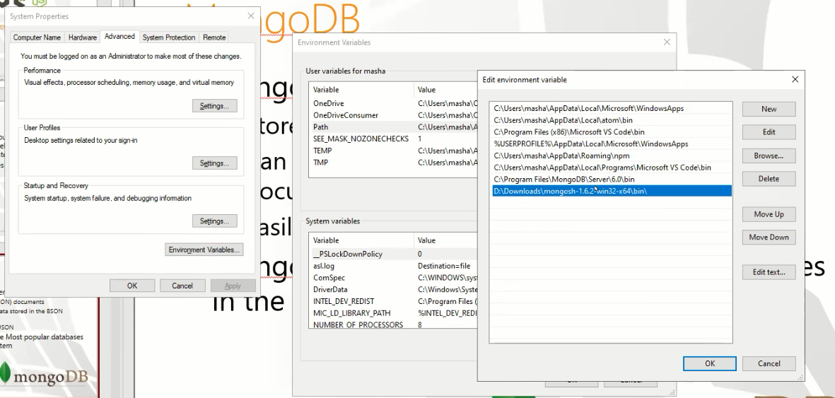
INSTALL
https://www.mongodb.com/try/download/community

Slide 10
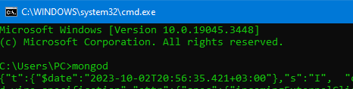
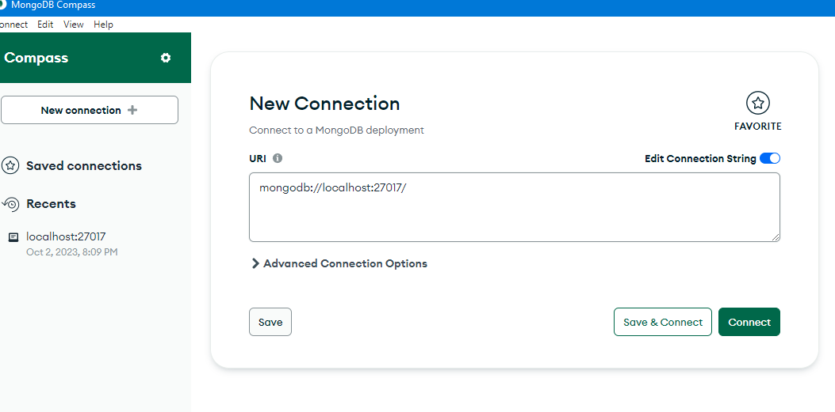
Connect

Slide 11
Mongoose Hello World
import express from "express";
import mongoose from "mongoose"; const dbUrl = "mongodb://127.0.0.1:27017/projectDb"; const app = express(); app.get("/", (req, res) => {
const Cat = mongoose.model("Cat", { name: String });
const kitty = new Cat({ name: "Zildjian" });
kitty.save().then(() => console.log("meow"));
res.send("Hello kitty")});
mongoose
.connect(dbUrl)
.then(() => {
console.log("Database is connected");
app.listen(5000, () => {
console.log("Server is running");
});})
.catch((error) => {
console.log(error);});

Slide 12
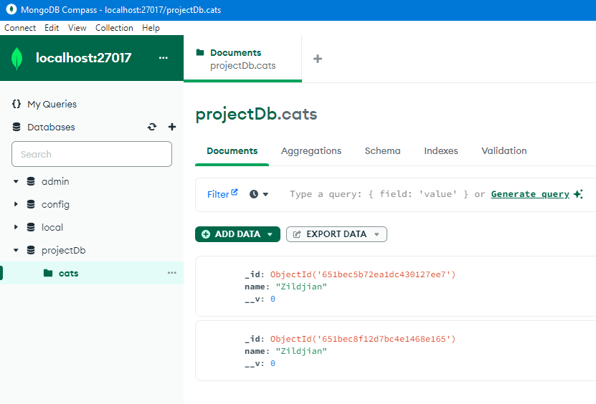
Compass

Slide 13
Mongoose Schema
/part3/Server2/ students
A mongoose schema is an object that maps to a MongoDB collection and defines the shape of the doucments within that collection.
import mongoose from "mongoose";
const Schema = mongoose.Schema;
const studentSchema = new Schema({
name: {
type: String,
required: true, // Name is required
minlength: 3, // Minimum length of name is 3 characters
},
id: {
type: Number,
required: true, // ID is required
unique: true, // ID must be unique
},
phone: {
type: String,
minlength: 10, // Assuming a minimum length of 10 digits for a phone number
},………………….

Slide 14
LAB
https://mongoosejs.com/docs/validation.html
Create the projects Model at db/models/projects

Slide 15
Mongoose Models
A model is a constructor that Mongoose creates for you based on a schema. It provides an interface to the database for creating, querying, updating, and deleting records. Essentially, a model represents a collection in the database, and the instances of this model represent documents in that collection.
const User = mongoose.model('User', userSchema);
const newUser = new User({name: 'Alice', age: 25, email: 'alice@example.com’}); newUser.save();
User.find({name: 'Alice'}, (err, users) => {
// 'users' is an array of all users named Alice
});

Slide 16
Mongo ObjectId _id:
In MongoDB, the default identifier for documents is the ObjectId. It's a unique value that MongoDB assigns to each document by default, but you can also manually create an ObjectId.
The ObjectId is usually represented as a 24-character hexadecimal string. However, not every 24-character string is a valid ObjectId. Thus, before making a query by an ObjectId in MongoDB, especially when you get this ID from user input, you may want to check if the provided string is likely an ObjectId.
Mongoose, a popular ODM for MongoDB in Node.js, provides a utility method to check if a string is likely an ObjectId. Here's how you can use it:

Slide 17
Mongoose Models
part3\server2
Notes:
17

Slide 18
Querying with Mongoose
Mongoose supports the rich query syntax of MongoDb.
Documents can be retrieved using each models find, findById, findOne or where static methods.
Student.find({ size: 'small’ })
.where('createdDate’)
.gt(oneYearAgo)
.exec()
.then((doc)=>{});

Slide 19
Home Work
1.Build your own Projects collection and all crude
2.Advanced- build ui with Angular or react
3.Veary advanced: same as 2 show all at table, add search that search at project name but use debounce for fast typing

Slide 20
Mongoose

Slide 21

Redis
Redis is an open source, advanced key-value cache and store
Commonly used as a distributed cache and session store for web applications

Slide 22
REDIS
docker run --name redis -p 6379:6379 -d redis:latest
docker exec -it redis redis-cli
SET mykey "Hello, World!"
GET mykey
KEYS *
KEYS *
INFO
Part5/server5
PING

Slide 23
MY SQL
docker exec -it mysql mysql -uroot -p
CREATE DATABASE northwind;
SHOW DATABASES;
show tables;
https://github.com/mrin9/northwind/blob/master/data_extended.sql
KEYS *
Part5/server6
Part5/server7

Slide 24
MY SQL The Real world
USE REPLACMENT
SQL = `INSERT INTO genie_conversations (topic_id, user_header, user_1, created_at)
VALUES (:topic_id, :header, :message, UTC_TIMESTAMP()) `;
const newConversation = await this.sequelize.query(newConversationSQL, {
replacements: { topic_id, header, message },
type: QueryTypes.INSERT,
});
KEYS *

